Slide 1
Tutorial 1 Learning Topology Optimization Through Examples and Case Studies
August 18, 2019

Slide 2
Problem Description
Cantilever Beam Problem
Units: MKS
Material: AlloySteel
Structural Loads: 1000N
Mesh Size: use default mesh size
TopOpt Constraints: No Constraints
TopOpt Objective: Minimum Compliance
Goal: Optimize the topology for a volume fraction of 0.25
1000N
Use SIMP Method for Topology Optimization

Slide 3
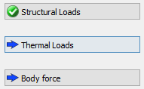
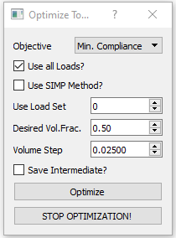
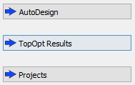
SIMP based TO using Pareto
Choose Units
Load Geometry
Define Material
Apply Loads (Structural/Thermal/Gravity)
Carry out FEA
Apply Top Opt Constraints
Topology Optimization
PostProcessing

Slide 4
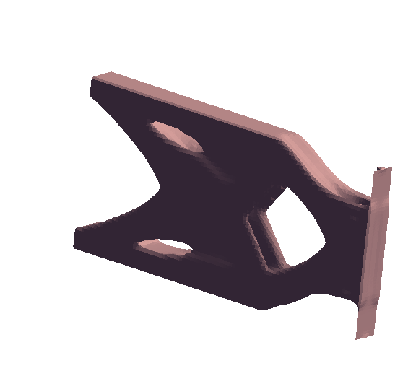
Results

